Slide 1


Machine Learning
Zheng Yimin / NSDAI -01 / P7053148

Slide 2
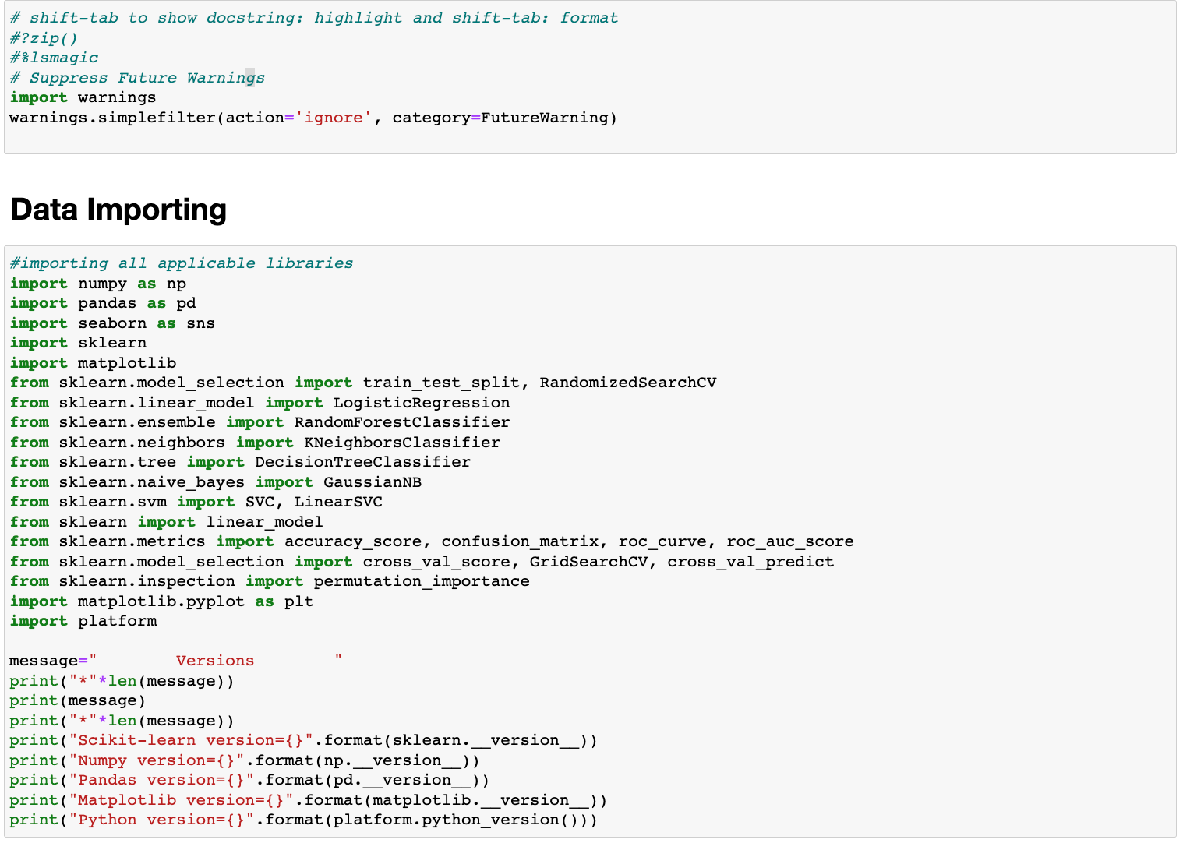
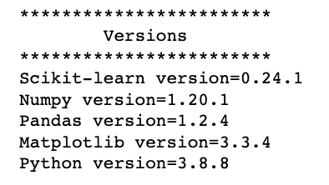
C L A S S I F I C A T I O N : T I T A N I C D A T A S E T
Import Data
EDA
Data Preparation
Train Model
Model Evaluation
Model re-training

Slide 3
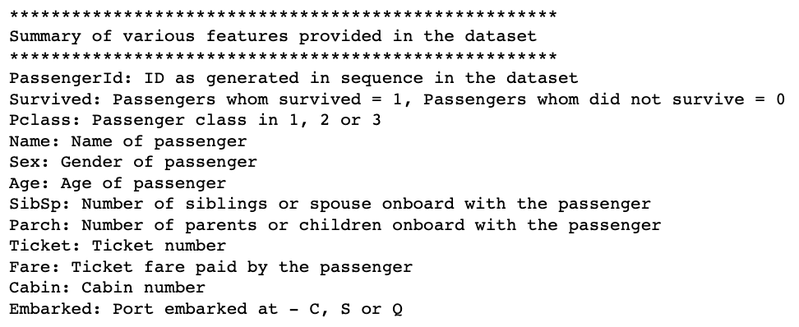
C L A S S I F I C A T I O N : T I T A N I C D A T A S E T
Import Data
EDA
Data Preparation
Train Model
Model Evaluation
Model re-training

Slide 4
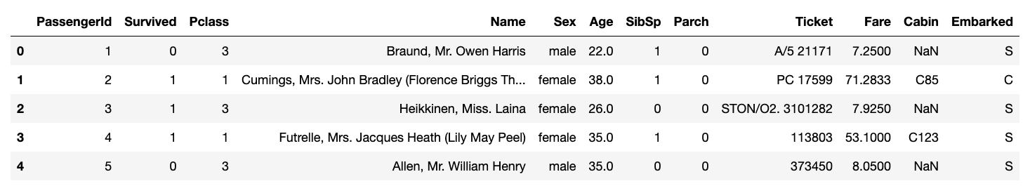
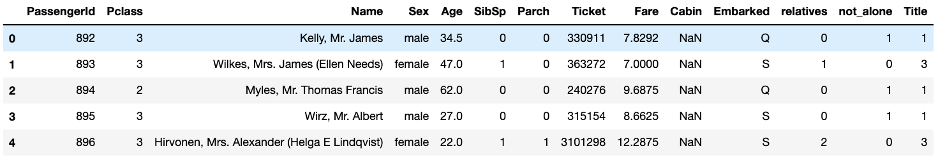
C L A S S I F I C A T I O N : T I T A N I C D A T A S E T
Train Dataset
Test Dataset
Import Data
EDA
Data Preparation
Train Model
Model Evaluation
Model re-training

Slide 5
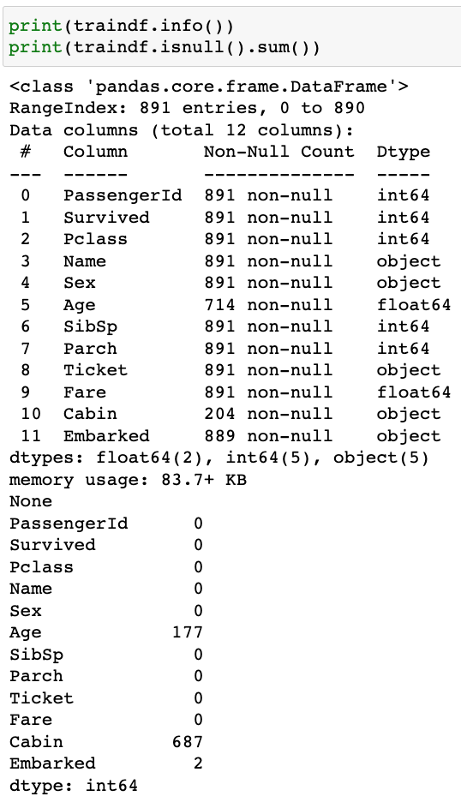
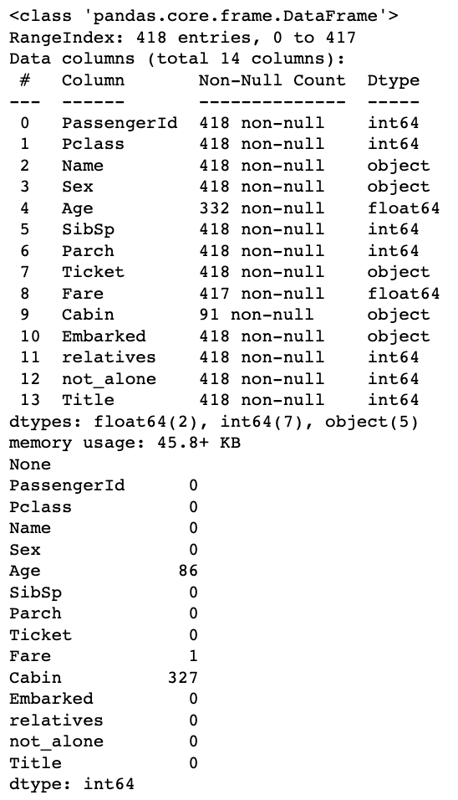
C L A S S I F I C A T I O N : T I T A N I C D A T A S E T
Import Data
EDA
Data Preparation
Train Model
Model Evaluation
Model re-training

Slide 6
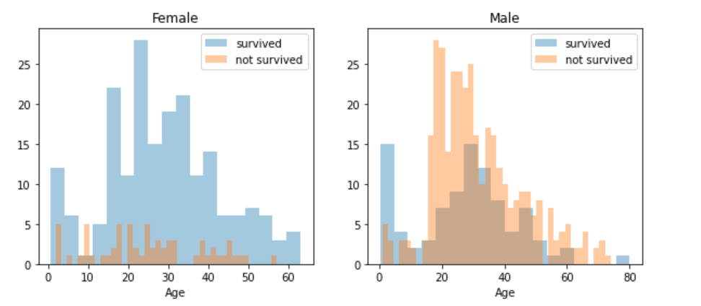
C L A S S I F I C A T I O N : T I T A N I C D A T A S E T
1. AGE & SEX
Import Data
EDA
Data Preparation
Train Model
Model Evaluation
Model re-training

Slide 7
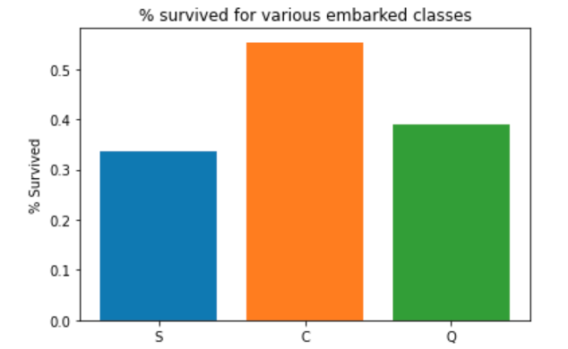
C L A S S I F I C A T I O N : T I T A N I C D A T A S E T
2. EMBARKED CLASS
Import Data
EDA
Data Preparation
Train Model
Model Evaluation
Model re-training

Slide 8
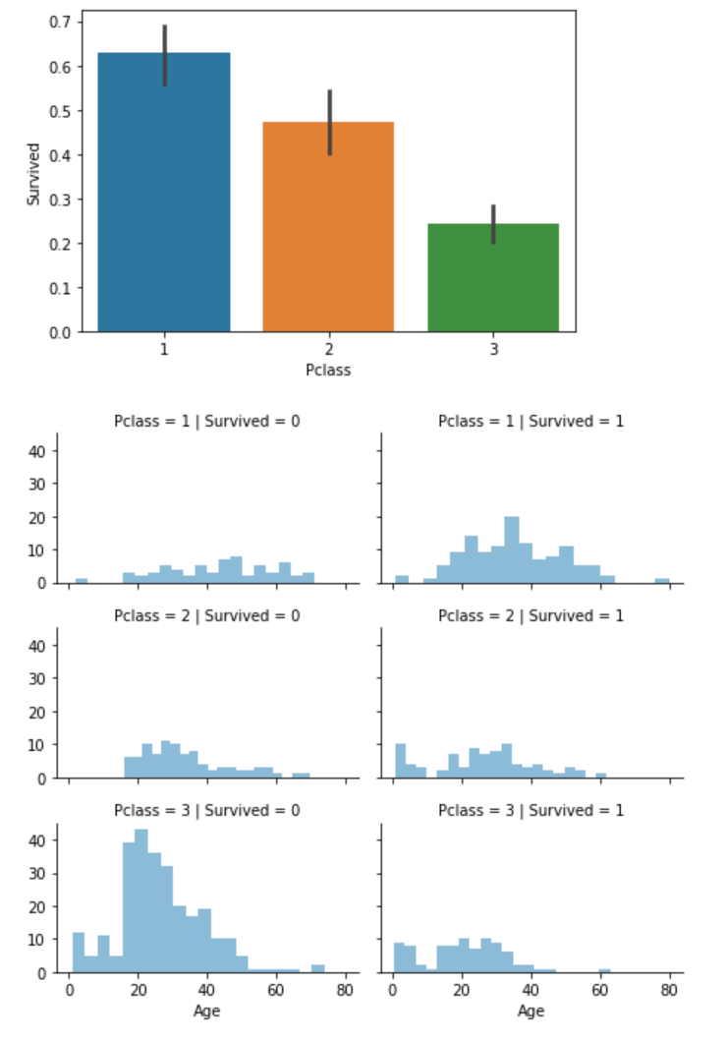
C L A S S I F I C A T I O N : T I T A N I C D A T A S E T
3. PCLASS
Import Data
EDA
Data Preparation
Train Model
Model Evaluation
Model re-training

Slide 9
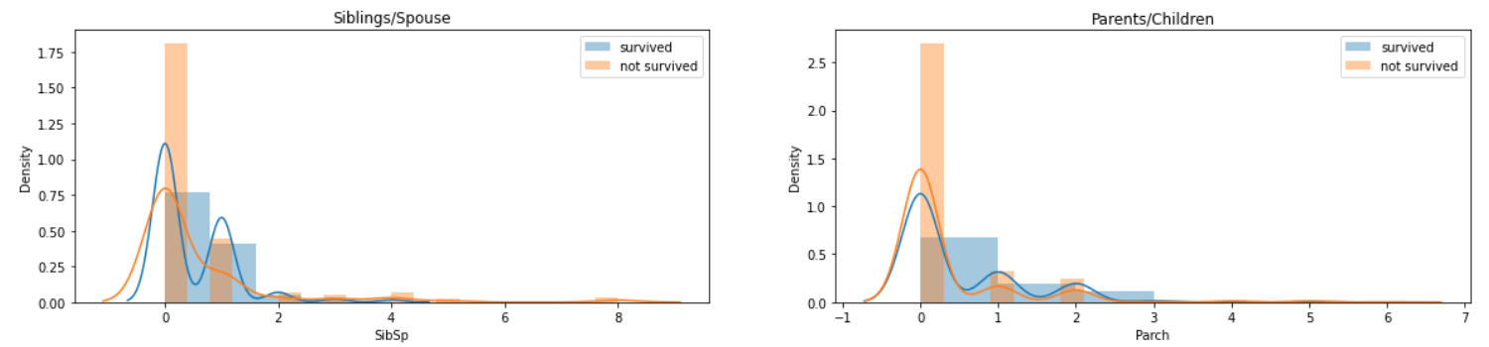
C L A S S I F I C A T I O N : T I T A N I C D A T A S E T
4. SIBLINGS/SPOUSE
5. PARENTS/CHILDREN
Import Data
EDA
Data Preparation
Train Model
Model Evaluation
Model re-training

Slide 10
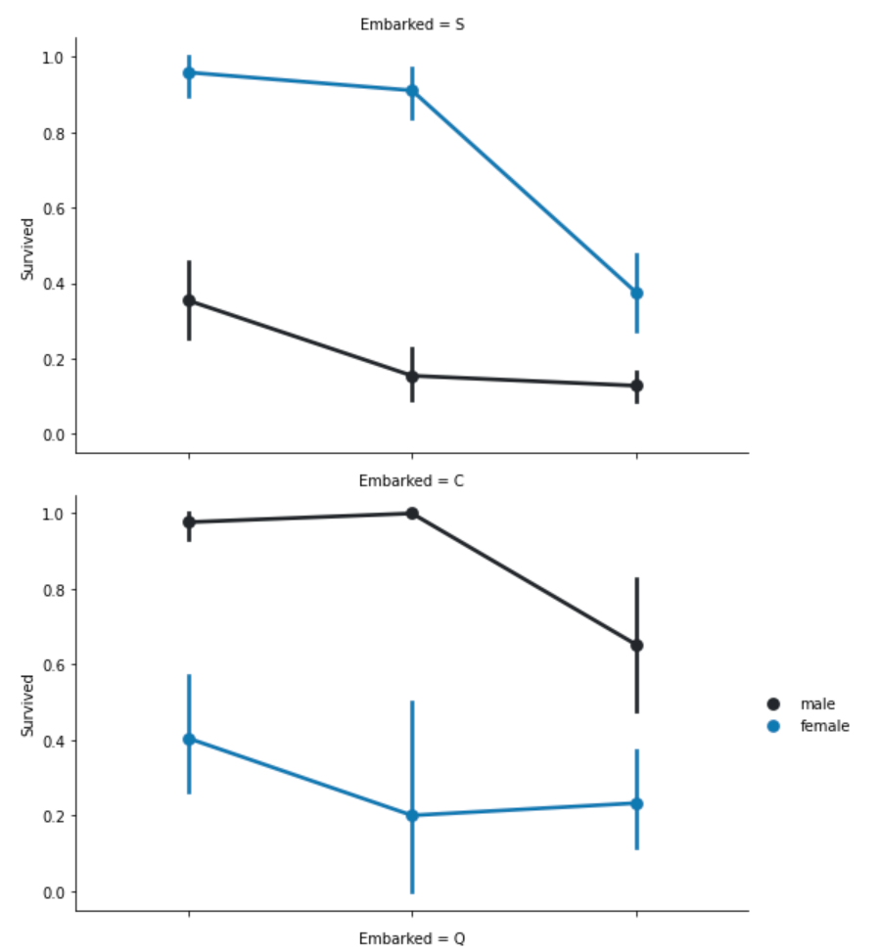
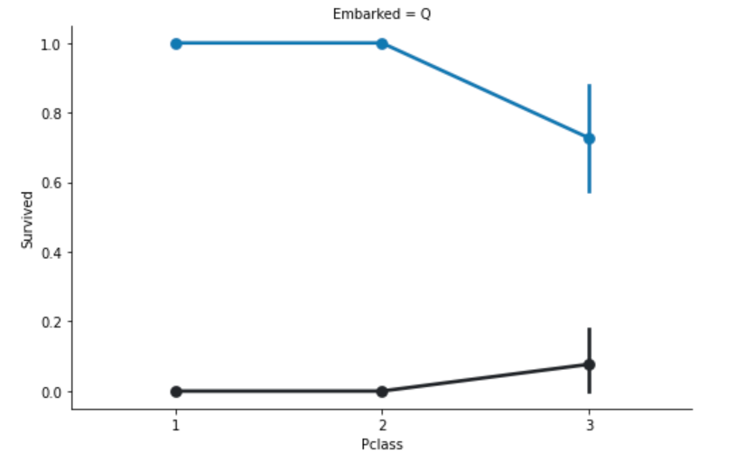
C L A S S I F I C A T I O N : T I T A N I C D A T A S E T
6. PCLASS, EMBARKED AND SEX
> MALE
> FEMALE
Import Data
EDA
Data Preparation
Train Model
Model Evaluation
Model re-training

Slide 11
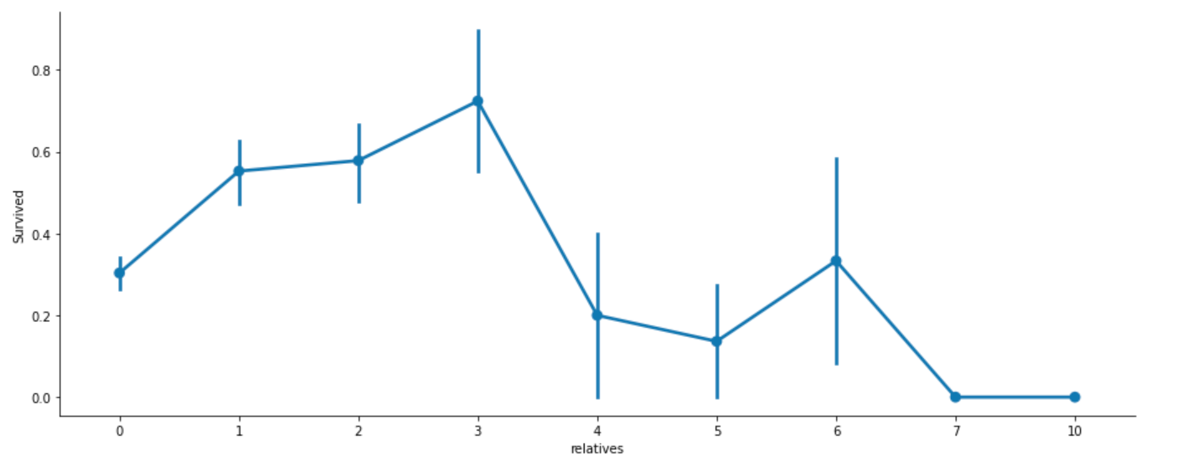
C L A S S I F I C A T I O N : T I T A N I C D A T A S E T
7. RELATIVES – SIBSP + PARCH
Import Data
EDA
Data Preparation
Train Model
Model Evaluation
Model re-training

Slide 12
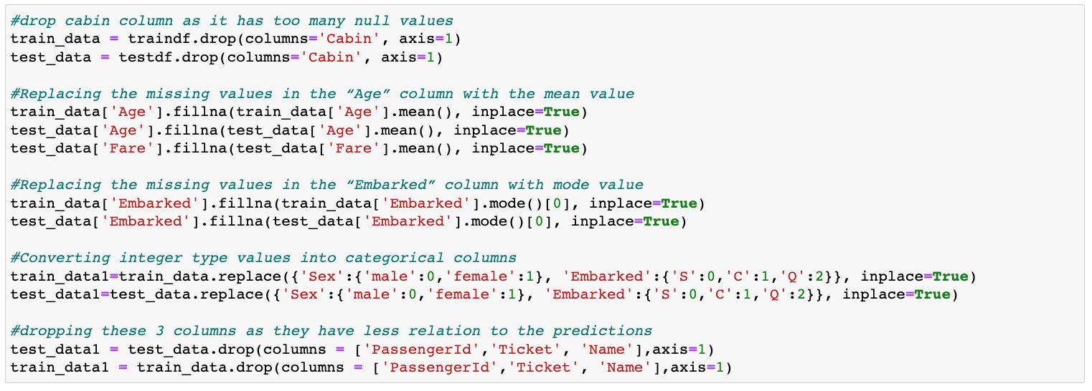
C L A S S I F I C A T I O N : T I T A N I C D A T A S E T
Dropped:
Cabin
Modified Null values for:
Age
Embarked
Fare (test_data)
Replaced categories with values for:
Sex
Embarked
Import Data
EDA
Data Preparation
Train Model
Model Evaluation
Model re-training

Slide 13
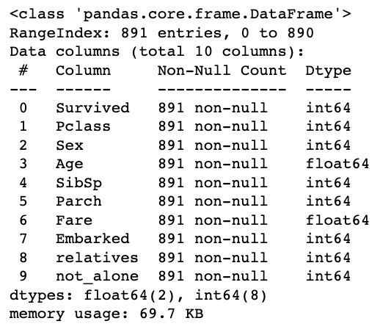
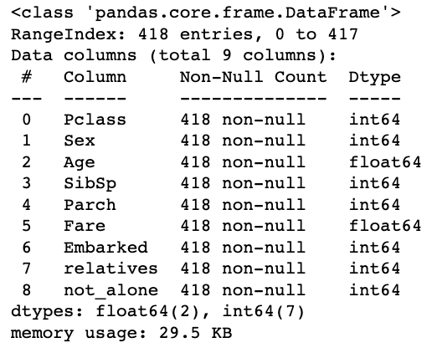
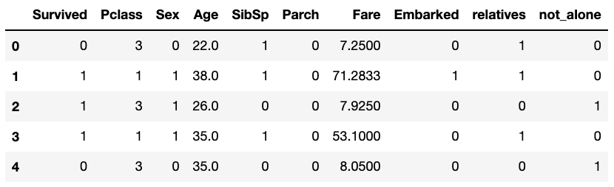
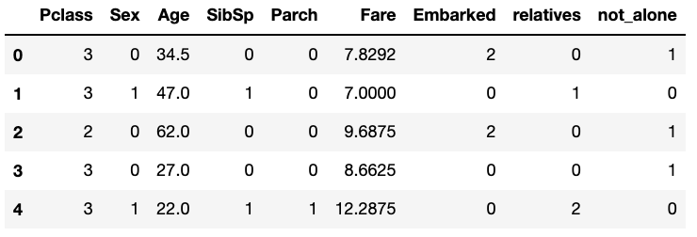
C L A S S I F I C A T I O N : T I T A N I C D A T A S E T
Train Dataset
Test Dataset
Import Data
EDA
Data Preparation
Train Model
Model Evaluation
Model re-training

Slide 14
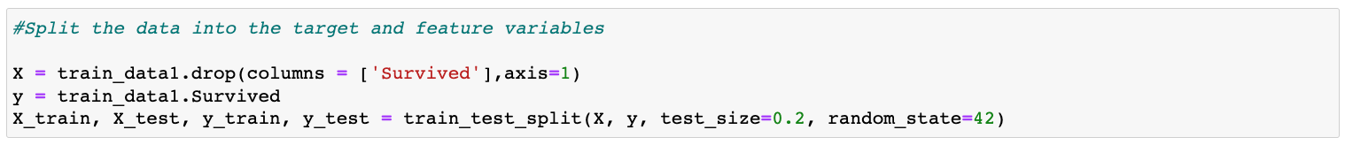
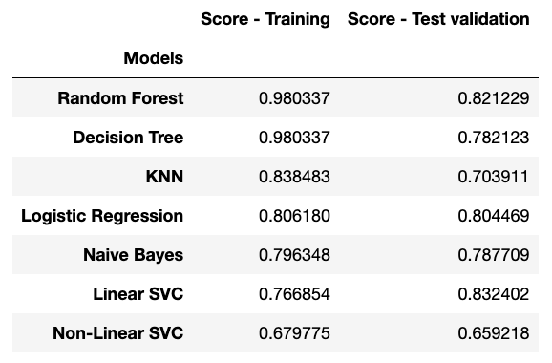
C L A S S I F I C A T I O N : T I T A N I C D A T A S E T
Import Data
EDA
Data Preparation
Train Model
Model Evaluation
Model re-training

Slide 15
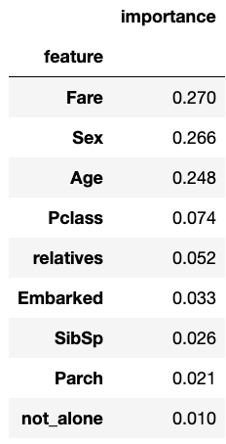
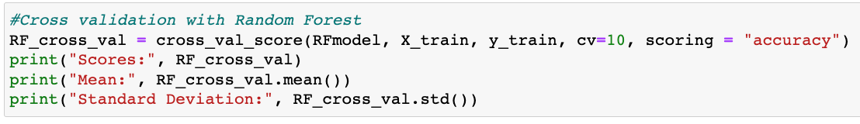
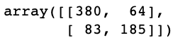
C L A S S I F I C A T I O N : T I T A N I C D A T A S E T
1. Cross-validation score
Scores: [0.80555556 0.76388889 0.73239437 0.83098592 0.76056338 0.77464789
0.77464789 0.78873239 0.81690141 0.87323944]
Mean: 0.7921557120500783
Standard Deviation: 0.038558442032076416
3. Confusion Matrix
2. features_importances
Import Data
EDA
Data Preparation
Train Model
Model Evaluation
Model re-training

Slide 16
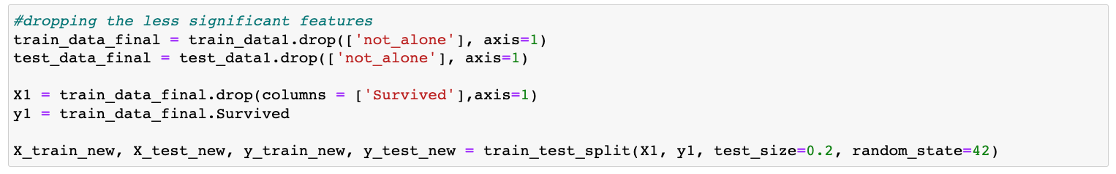
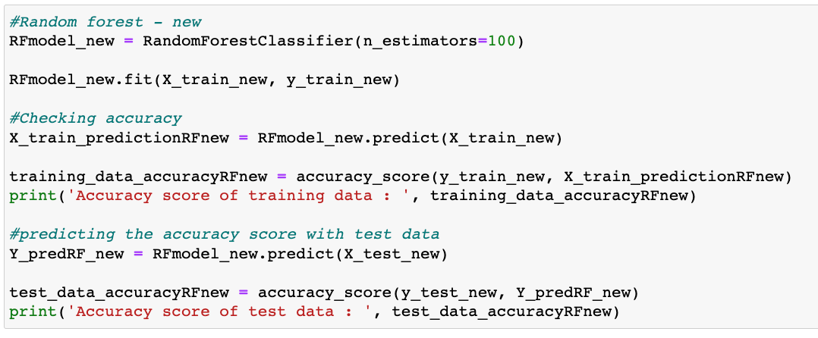
C L A S S I F I C A T I O N : T I T A N I C D A T A S E T
Dropping column(s) and
reorganizing train /
test(validation) data set
2. Re-training Random
Forest model
Import Data
EDA
Data Preparation
Train Model
Model Evaluation
Model re-training

Slide 17
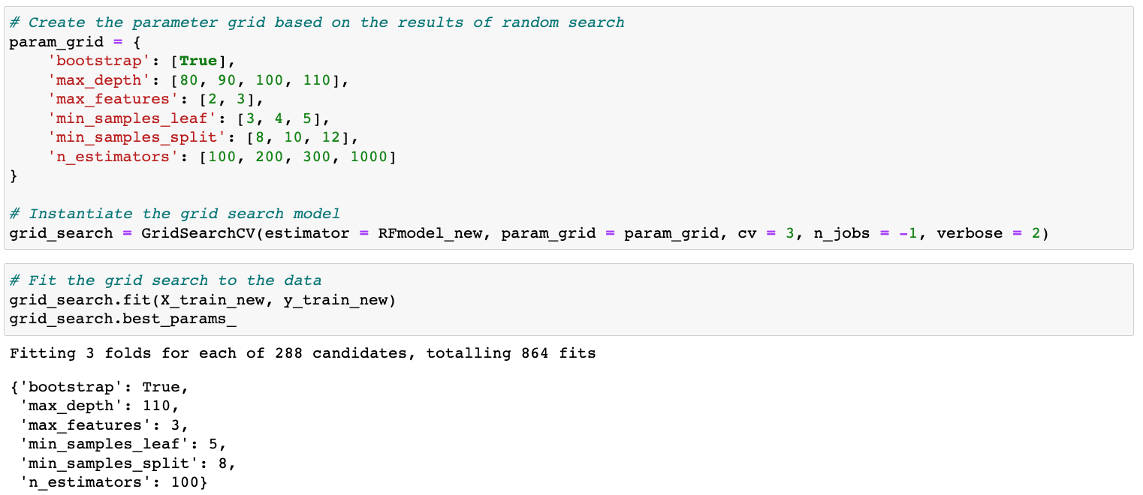
C L A S S I F I C A T I O N : T I T A N I C D A T A S E T
3. Hyperparameter
tuning
Import Data
EDA
Data Preparation
Train Model
Model Evaluation
Model re-training

Slide 18
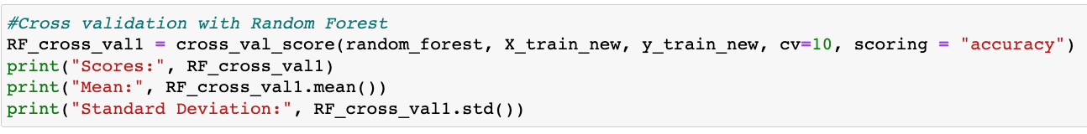
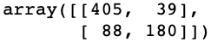
C L A S S I F I C A T I O N : T I T A N I C D A T A S E T
1. Cross-validation score
Scores: [0.86111111 0.81944444 0.76056338 0.97183099 0.83098592 0.76056338
0.83098592 0.76056338 0.74647887 0.90140845]
Mean: 0.8243935837245697
Standard Deviation: 0.06886381669545112
2. Confusion Matrix
Import Data
EDA
Data Preparation
Train Model
Model Evaluation
Model re-training

Slide 19
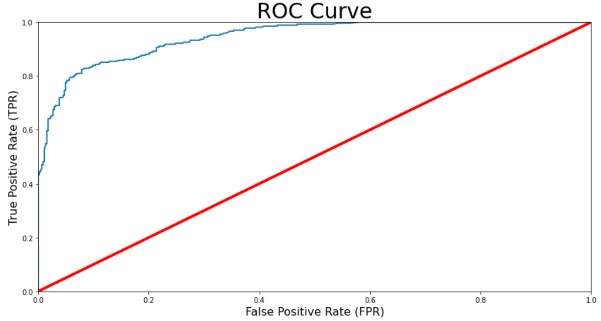
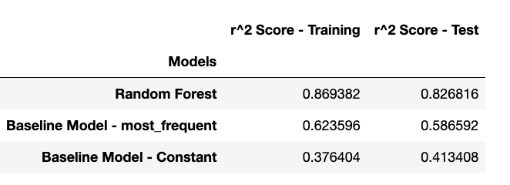
C L A S S I F I C A T I O N : T I T A N I C D A T A S E T
ROC-AUC Score = 94.44%
Import Data
EDA
Data Preparation
Train Model
Model Evaluation
Model re-training

Slide 20
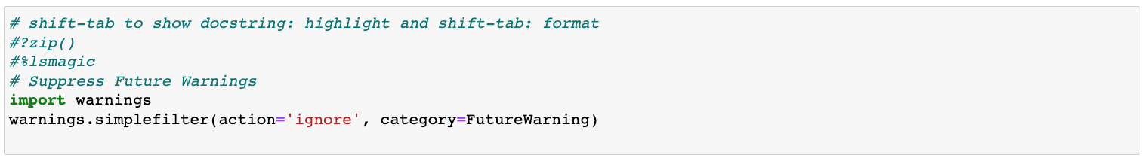
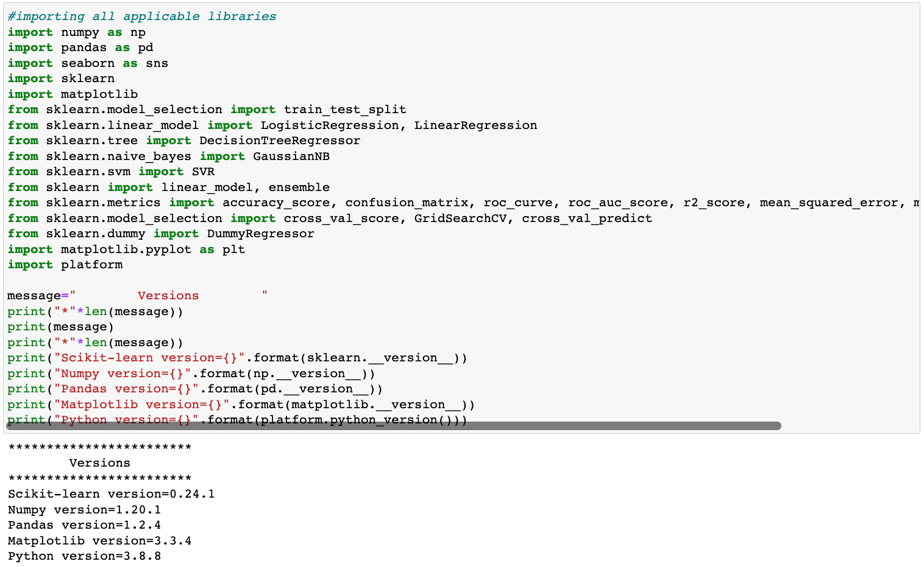
R E G R E S S I O N : H O U S I N G P R I C E S D A T A S E T
Import Data
EDA
Data Preparation
Train Model
Model Evaluation
Model re-training

Slide 21
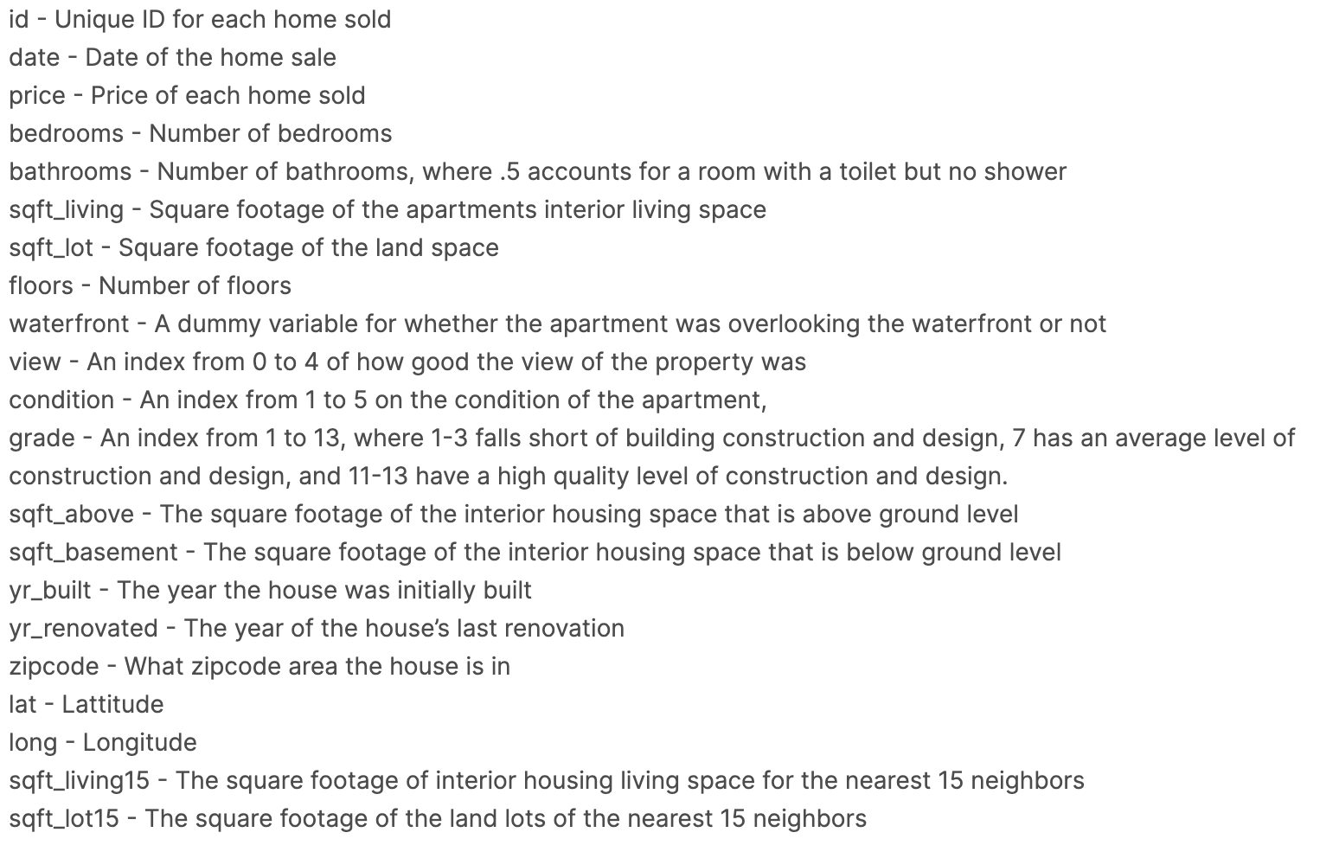
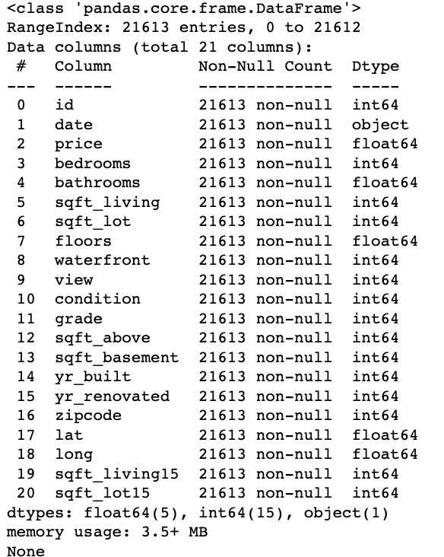
R E G R E S S I O N : H O U S I N G P R I C E S D A T A S E T
Import Data
EDA
Data Preparation
Train Model
Model Evaluation
Model re-training

Slide 22
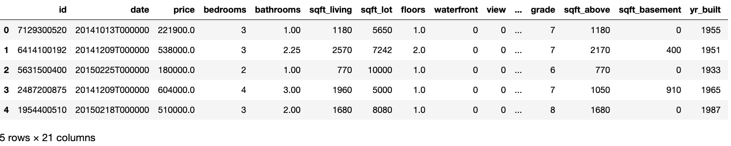
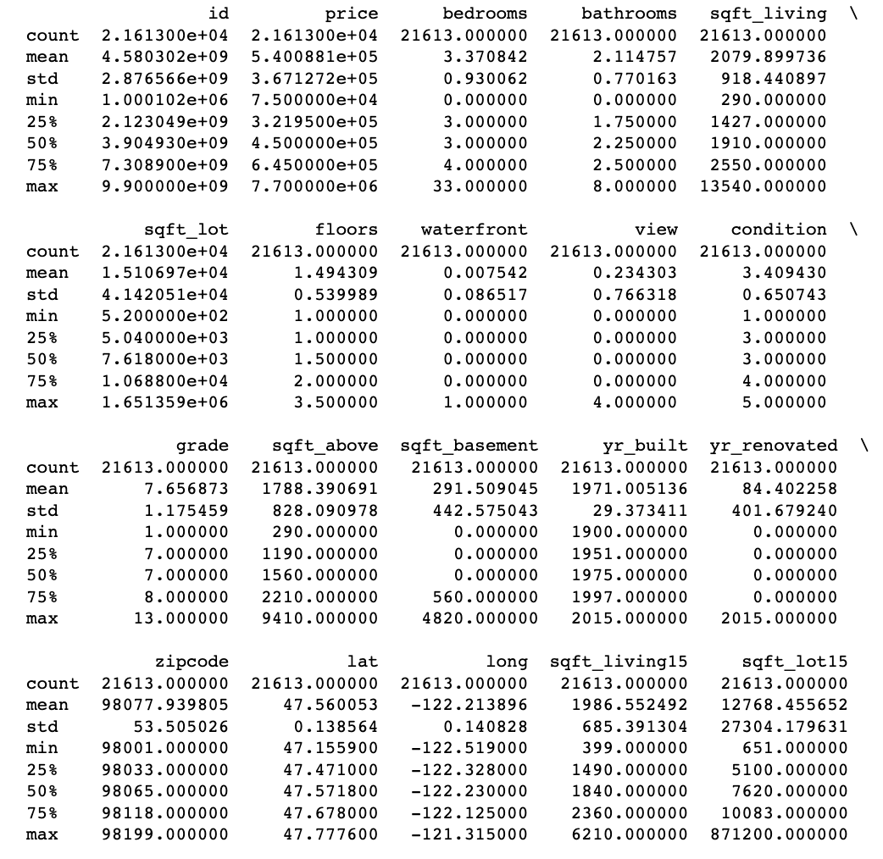
R E G R E S S I O N : H O U S I N G P R I C E S D A T A S E T
Import Data
EDA
Data Preparation
Train Model
Model Evaluation
Model re-training

Slide 23
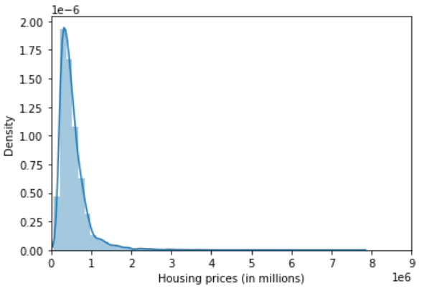
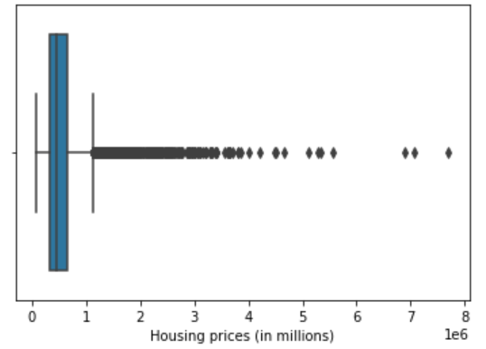
R E G R E S S I O N : H O U S I N G P R I C E S D A T A S E T
Import Data
EDA
Data Preparation
Train Model
Model Evaluation
Model re-training

Slide 24
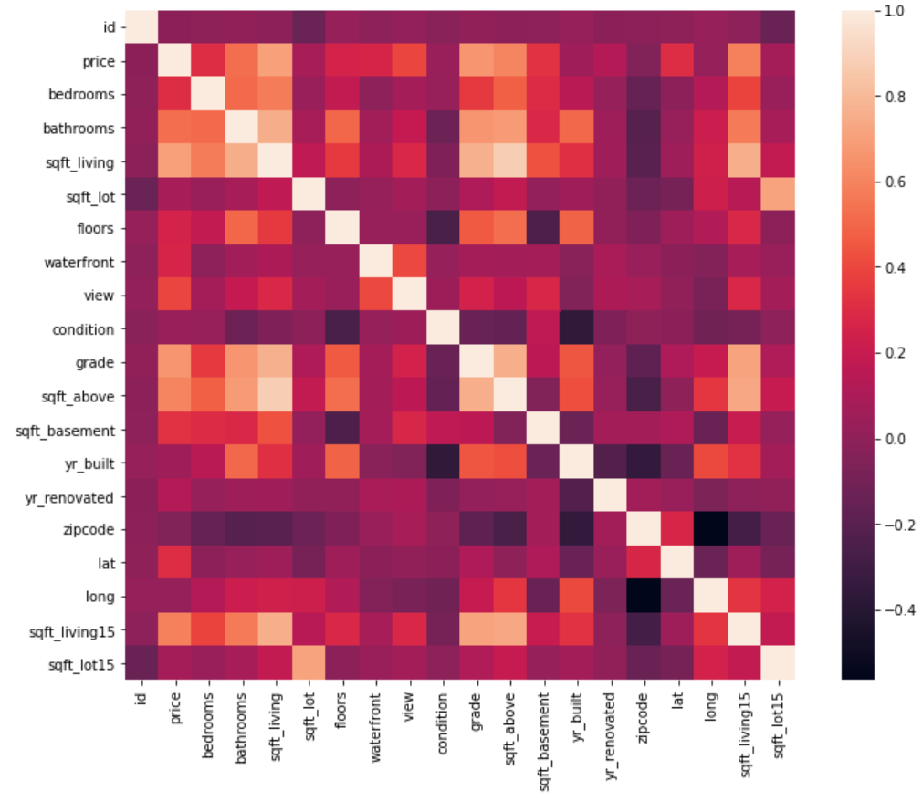
R E G R E S S I O N : H O U S I N G P R I C E S D A T A S E T
Import Data
EDA
Data Preparation
Train Model
Model Evaluation
Model re-training

Slide 25
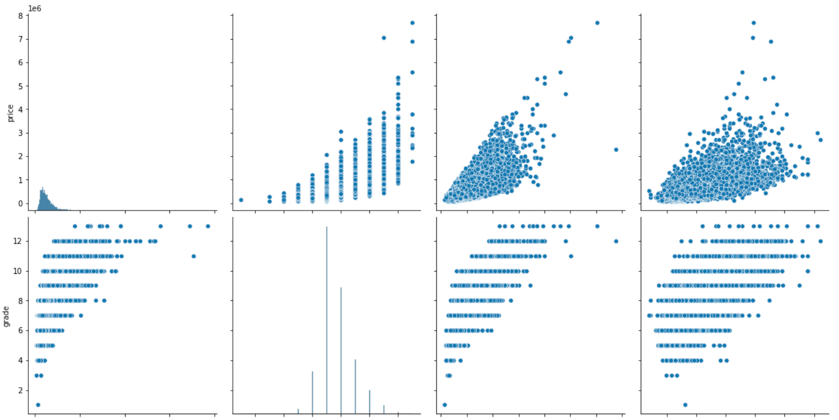
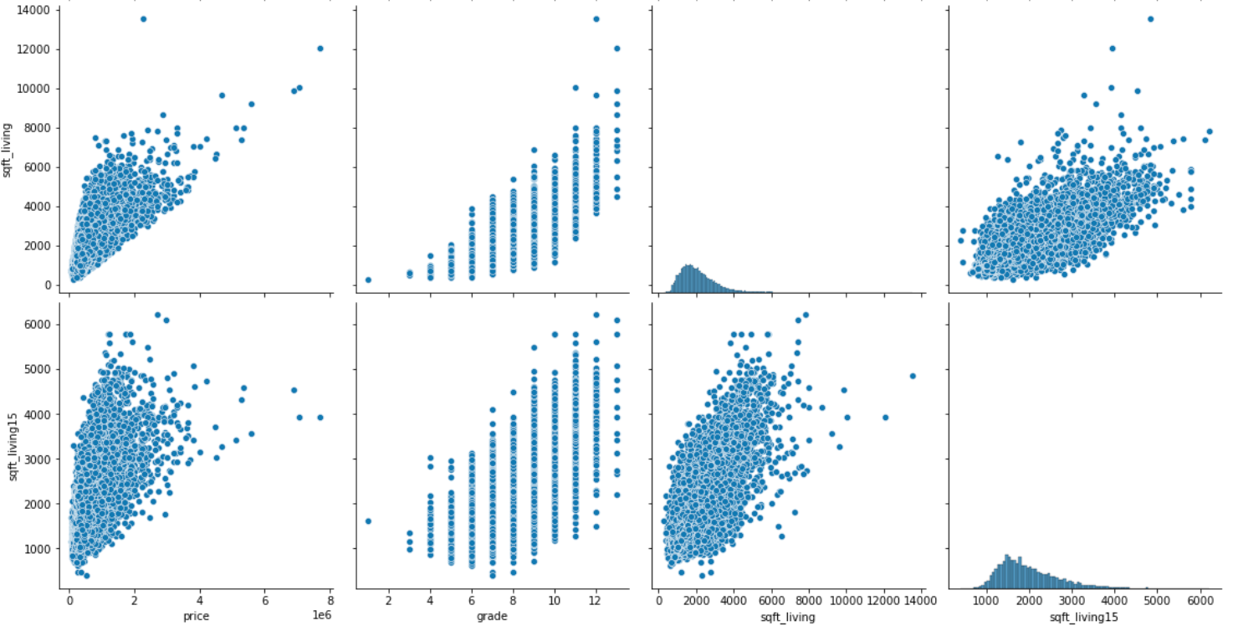
R E G R E S S I O N : H O U S I N G P R I C E S D A T A S E T
Top 4 correlated features
Import Data
EDA
Data Preparation
Train Model
Model Evaluation
Model re-training

Slide 26
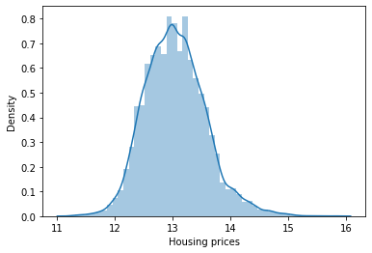
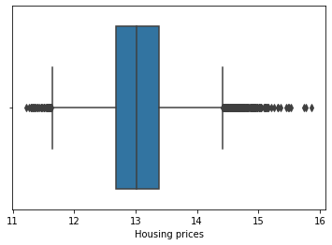
R E G R E S S I O N : H O U S I N G P R I C E S D A T A S E T
Added:
Numpy_log for prices of houses
Import Data
EDA
Data Preparation
Train Model
Model Evaluation
Model re-training

Slide 27
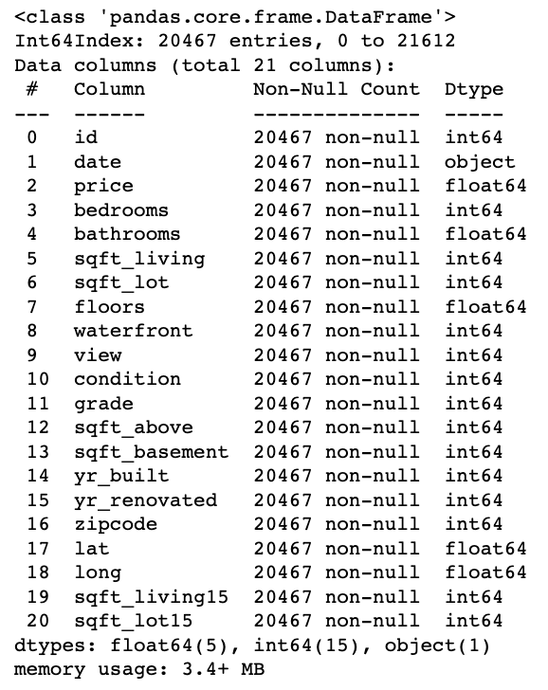
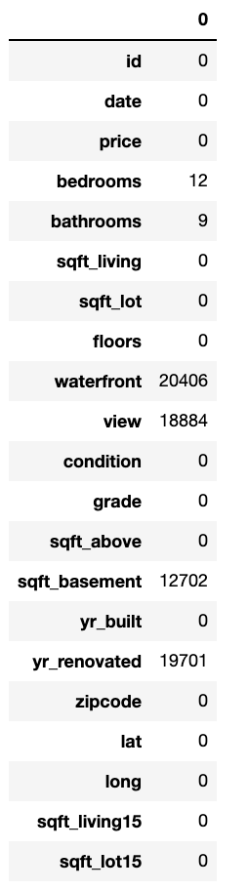
R E G R E S S I O N : H O U S I N G P R I C E S D A T A S E T
Dropped:
Outliers for sqft_living + price
Waterfront
View
Sqft_basement
Yr_renovated
Import Data
EDA
Data Preparation
Train Model
Model Evaluation
Model re-training

Slide 28
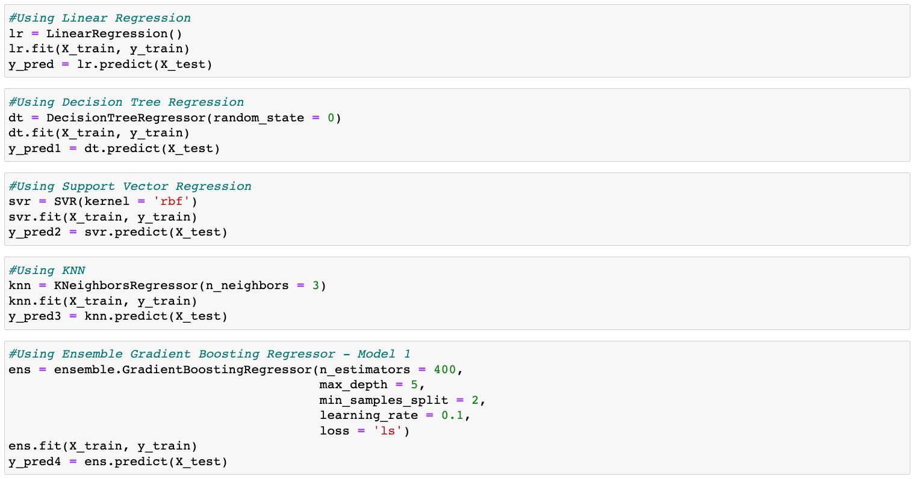
R E G R E S S I O N : H O U S I N G P R I C E S D A T A S E T
Import Data
EDA
Data Preparation
Train Model
Model Evaluation
Model re-training

Slide 29
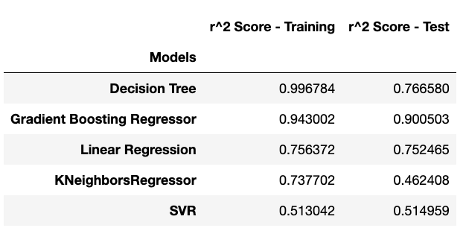
R E G R E S S I O N : H O U S I N G P R I C E S D A T A S E T
Import Data
EDA
Data Preparation
Train Model
Model Evaluation
Model re-training

Slide 30
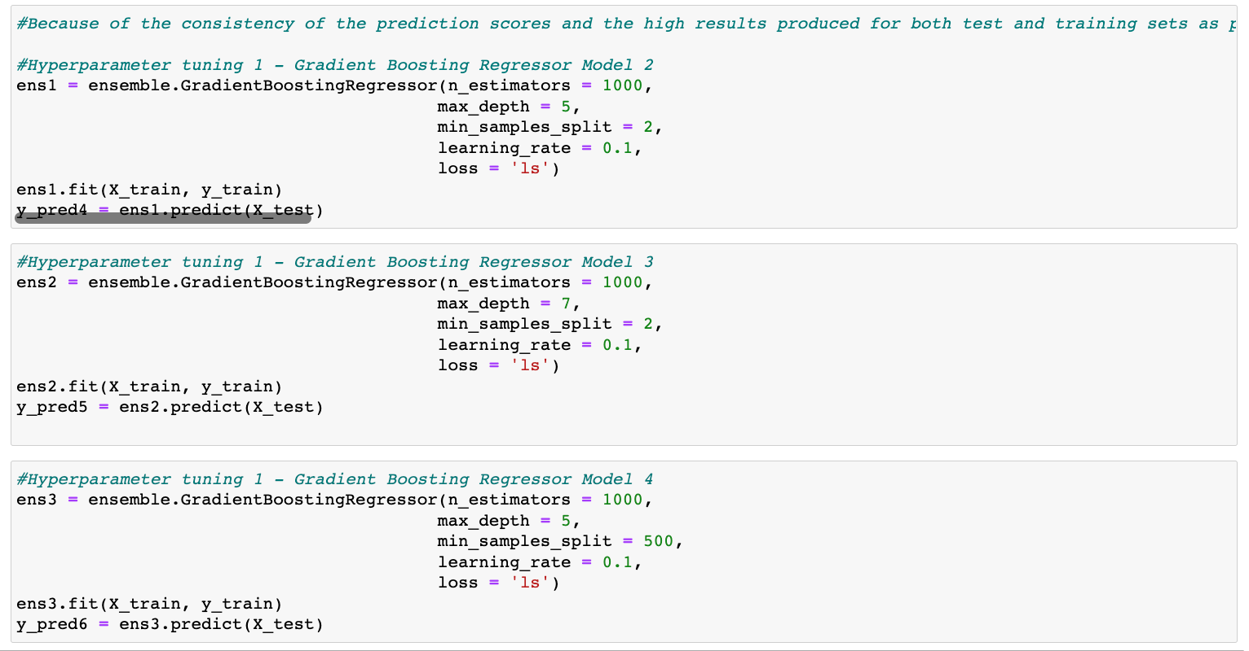
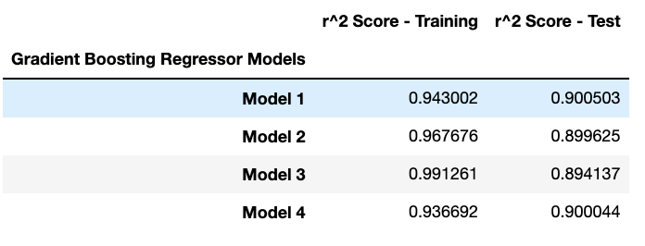
R E G R E S S I O N : H O U S I N G P R I C E S D A T A S E T
Hyperparameter tuning
Import Data
EDA
Data Preparation
Train Model
Model Evaluation
Model re-training

Slide 31

R E G R E S S I O N : H O U S I N G P R I C E S D A T A S E T
Import Data
EDA
Data Preparation
Train Model
Model Evaluation
Model re-training

